Slide 1
Disciple
Do You See A
In The Mirror?
Luke 6:40

Slide 3
Disciple
Do You See A
In The Mirror?
Luke 6:40

Slide 4
Disciple
Follower
Student
Learner
Apprentice

Slide 5
On A Mission To Grow
Disciples
Deeper in our relationship with God
Closer in our fellowship as a Church
Bolder in our proclamation of the Gospel

Slide 7
“If you abide in my word, you are my disciples indeed,” John 8:31
“But I do know Him and keep His Word,” John 8:55
“A Disciple is not above his teacher, but everyone when he is fully trained will be like his teacher,” Luke 6:40

Slide 8
ABIDING IN
GOD’S
WORD
Colossians 2:4-7

Slide 9
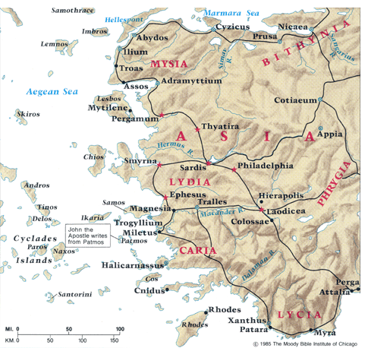

Slide 10
Approximately 10 miles separated Colossae and Laodicea
Paul hadn’t made it there, but God’s Word had!

Slide 11
ABIDING IN
GOD’S
WORD
Colossians 2:4-7

Slide 12
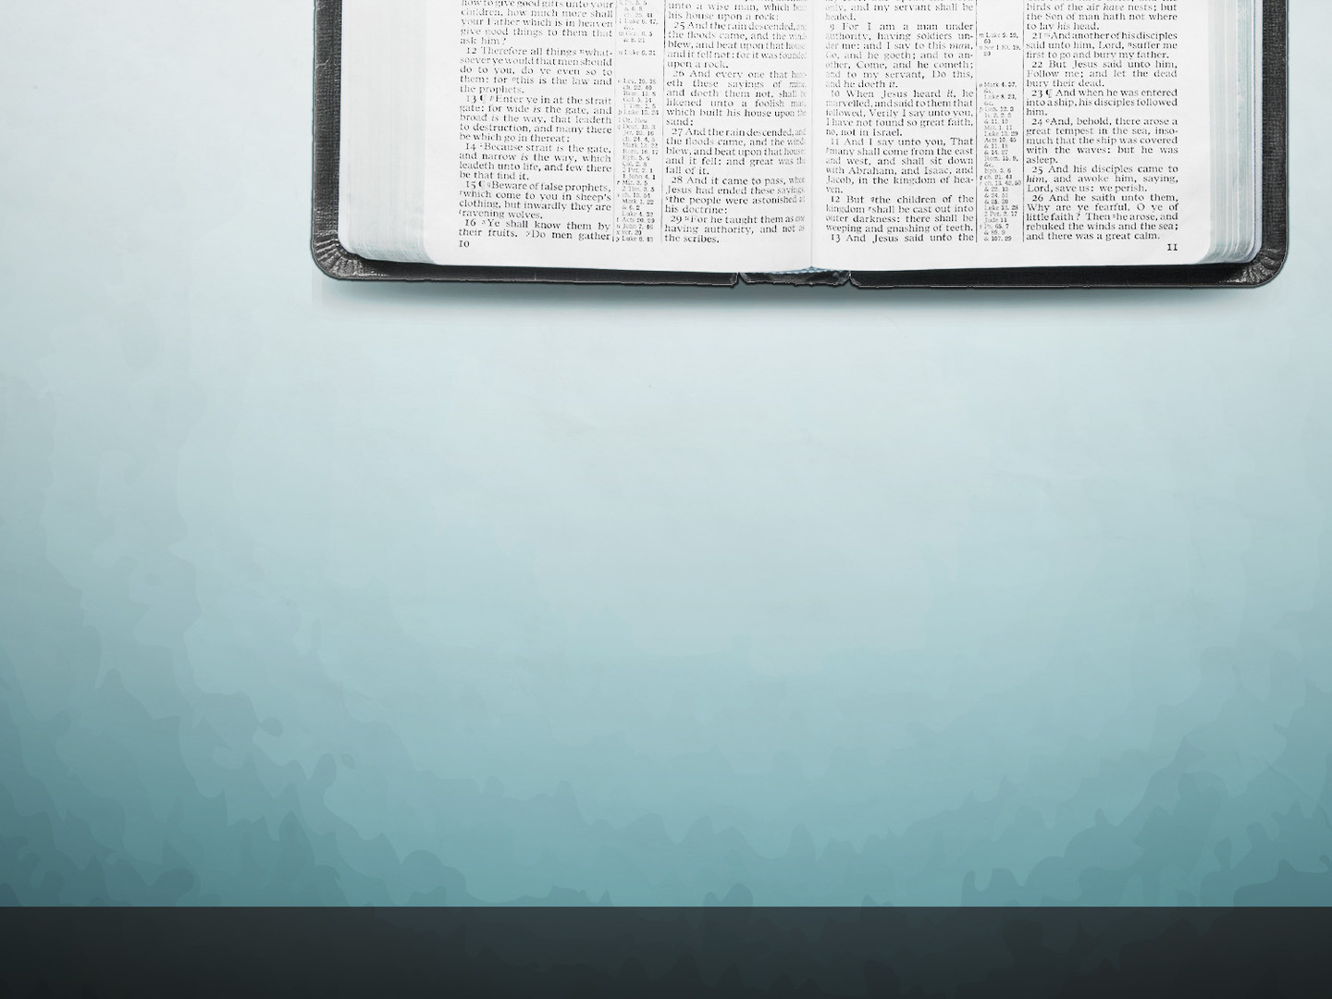
ABIDING IN
GOD’S
WORD
Reveals Order To The Church
“rejoicing to see your good order,” Colossians 2:5

Slide 13
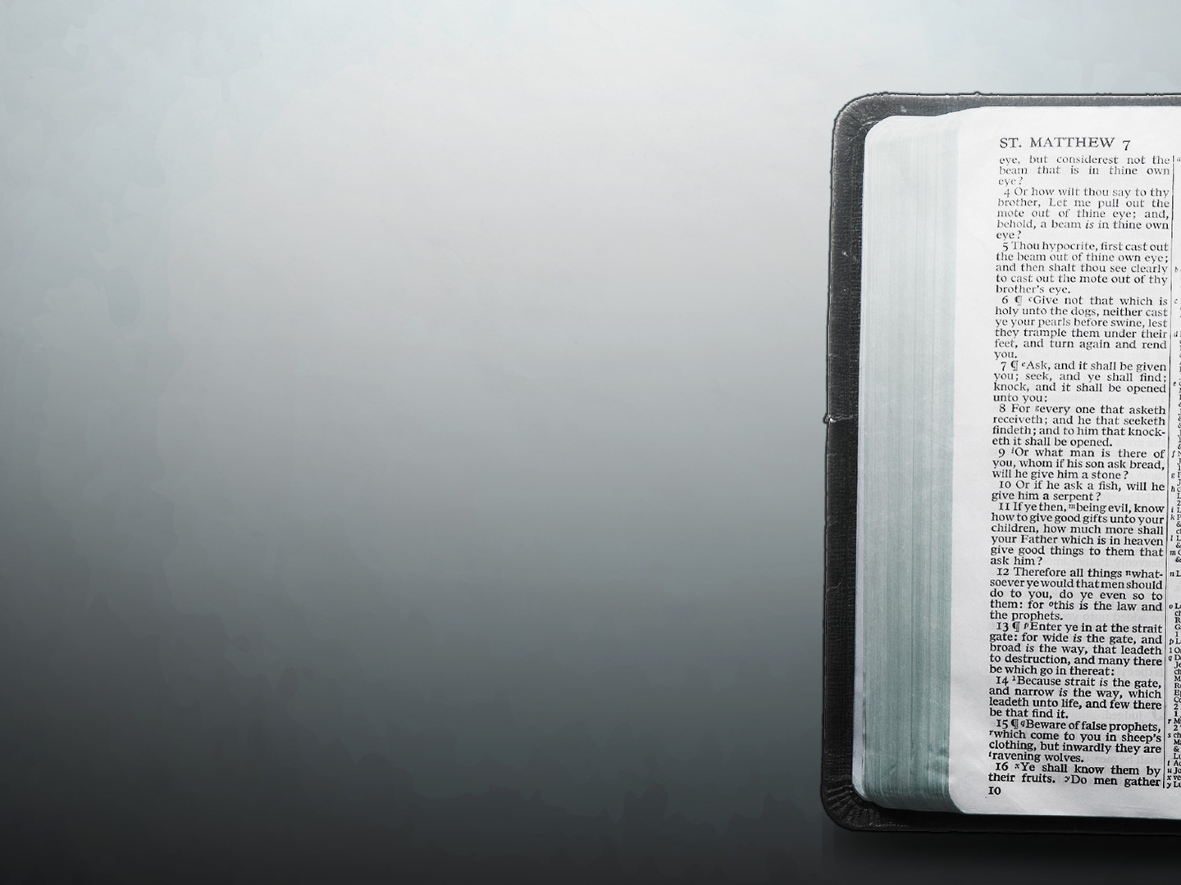
Apostles Taught Uniformly & Uniformity in the Churches
1 Cor 4:17, “…who will remind you of my ways in Christ, as I teach everywhere in every church.”
1 Cor 7:17, “And so I ordain in all the churches.”
1 Cor 11:34, “And the rest I will set in order when I come.”
1 Cor. 14:33, “For God is not the author of confusion but of peace, as in all the churches of the saints.”
1 Cor 16:1, “…as I have given orders to the churches of Galatia, so you must do also.”

Slide 14
Order to the Christian Life
2 Thessalonians 3:6, “But we command you, brethren, in the name of our Lord Jesus Christ, that you withdraw from every brother who walks disorderly and not according to the tradition which he received from us.”

Slide 15
Order to the Assemblies
1 Corinthians 14:40, “Let all things be done decently and in order.”
An Assembly (1 Cor. 11:18; Heb. 10:25)
Taught (1 Cor. 14:9; Acts 11:26; 20:7)
Prayed (1 Cor. 14:15; Acts 12:5)
Sang (1 Cor. 14:15, 26; Col. 3:16)
Communion on 1st Day (1 Cor. 11:17-34; Acts 20:7)
Giving on 1st Day (1 Cor. 16:1-2)

Slide 16
Order to the Organization of a Church
Titus 1:5, “For this reason I left you in Crete, that you should set in order the things that are lacking, and appoint elders in every city as I commanded you-”
Congregation (1 Cor. 1:2; Acts 14:23)
Elders – aka Pastors, Bishops (Phil. 1:1; Acts 14:23)
Deacons (Phil. 1:1)
Evangelists (1 Tim. 1:3; 4:6; 2 Tim. 4:5)
Teachers (Eph. 4:11)
Saints – aka Members (Phil. 1:1; Eph. 4:12; 1 Cor. 12:27)

Slide 17
Order to Corporate Action
Common Treasury (Acts 4:34-5:4; 1 Cor. 16:1-2)
Evangelism (1 Cor. 9:14; Phil. 4:15-16)
Edification (Eph. 4:11-16; 1 Thess. 5:11)
Benevolent Relief of Needy Saints (Acts 4:32-37; 6:1-7;11:27-30)

Slide 18
Order to the Doctrine of a Church
2 Timothy 1:13, “Hold fast the pattern of sound words which you have heard from me, in faith and love which are in Christ Jesus.”
1 Thessalonians 2:13, “For this reason we also thank God without ceasing, because when you received the word of God which you heard from us, you welcomed it not as the word of men, but as it is in truth, the word of God, which also effectively works in you who believe.”

Slide 19
ABIDING IN
GOD’S
WORD
Reveals The Faith of Christ
“rejoicing to see …the steadfastness of your faith in Christ,” Colossians 2:5

Slide 20
ABIDING IN
GOD’S
WORD
“rejoicing to see …the steadfastness of your faith in Christ,” Colossians 2:5
Stationed Determined Immovable

Slide 21
WARNINGS in Colossians 2
Don’t be Deceived by Flattery (2:4)
Don’t be Cheated by Philosophy & Men’s Traditions (2:8)
Don’t be Judged by Jewish Legalism (2:11-17)
Don’t be Cheated by Mysticism (2:18)
Don’t subject yourselves to Man-made Asceticism & will-worship (2:20-23)

Slide 22
ABIDING IN
GOD’S
WORD
What could move them away from faith in Christ?
Persecution?
False Teaching?
“rejoicing to see …the steadfastness of your faith in Christ,” Colossians 2:5

Slide 23
WARNINGS in Colossians 2
Don’t be Deceived by Flattery (2:4)
Don’t be Cheated by Philosophy & Men’s Traditions (2:8)
Don’t be Judged by Jewish Legalism (2:11-17)
Don’t be Cheated by Mysticism (2:18)
Don’t subject yourselves to Man-made Asceticism & will-worship (2:20-23)

Slide 24
ABIDING IN
GOD’S
WORD
Guides Our Walk In Christ
“walk in Christ as you received Him” - Colossians 2:6

Slide 25
ABIDING IN
GOD’S
WORD
God’s Word Brings Us To A Decision
Walk In It
Walk Away

Slide 26
ABIDING IN
GOD’S
WORD
Builds Up The Church
Rooted & Built Up & Established - Colossians 2:7

Slide 27
“As you…have received” – Col. 2:6
PARALLEL
“As you have been taught” – Col. 2:7

Slide 28
ABIDING IN
GOD’S
WORD
“Rooted” – Think Taproot
“Built Up” – Erecting a Building

Slide 29
ABIDING IN
GOD’S
WORD
Produces Thanksgiving
“abounding in it with thanksgiving,” Colossians 2:7

Slide 30
ABIDING IN
GOD’S
WORD
Colossians 2:4-7

