Slide 1
Bartlett TN 10/25/ 2020 Date & Authorship of Luke Scott Smelser

Slide 2
Date & Authorship of: scott smelser sbsmelser@comcast.net
LUKE
acts

Slide 3
Date & Authorship of: scott smelser sbsmelser@comcast.net
LUKE
acts

Slide 4
introductory notes on the significance of the Lucan texts
3

Slide 5
Who of the following wrote the largest percentage of the NT text?
1
Peter Paul John Luke
27+ %

Slide 6
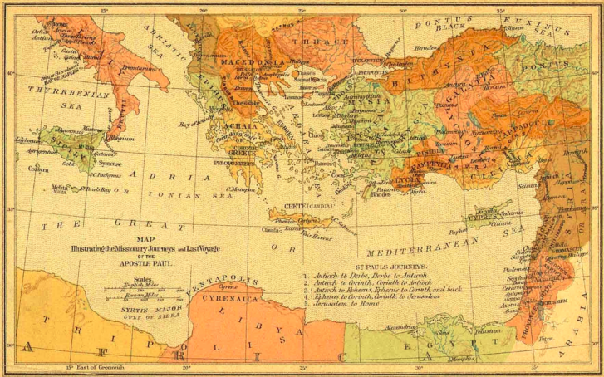
2
?
gospels
epistles
acts
of the apostles

Slide 7
3
VOL. 1
LUKE
VOL. II ACTS
BY DEFINITION - AND TO STATE THE OBVIOUS:
the 2 volume work is a
PROCLAMATION OF THE GOSPEL
& ITS OUTREACH TO THE LOST

Slide 8
But If your friend or colleague googles “Luke,” and goes to Wikipedia, this is what your friend will (currently) find:
The gospel of Luke and the Acts of the Apostles make up a two-volume work …
Together they account for 27.5% of the New Testament, the largest contribution by a single author…” ^{[19]}
The author is not named in either volume. ^{[11]}
According to a Church tradition dating from the 2nd century he was the Luke named as a companion of Paul

Slide 9
But If your friend or colleague googles “Luke,” and goes to Wikipedia, this is what your friend will (currently) find:
presentingEVIDENCE
FOR LUKE
AS AUTHOR
but "a critical consensus emphasizes the countless contradictions between the account in Acts and the authentic Pauline letters."^{[12]} An example can be seen by comparing Acts' accounts of Paul's conversion (Acts 9:1–31, 22:6–21, and 26:9–23) with Paul's own statement that he remained unknown to Christians in Judea after that event (Galatians 1:17–24).^{[20]}
The eclipse of the traditional attribution to Luke the companion of Paul has meant that an early date for the gospel is now rarely put forward.^{[12 ]} Most scholars date the composition of the combined work to around 80–90 AD, although some others suggest 90–110,^{[23]}
“NOT LUKE”
presentingEVIDENCE FOR
A DATE IN EARLY 60’s
“NOT EARLY”

Slide 10
But first a short note on that “contradiction” with Gal. 1
“comparing Acts' accounts of Paul's conversion (Acts 9:1–31, 22:6–21, and 26:9–23) with Paul's own statement that he remained unknown to Christians in Judea after that event (Galatians 1:17–24).^{[20]} ”
ACTS 1.8 … you will be my witnesses in Jerusalem and in all Judea…
Act 9:26-28 ESV
And when he had come to Jerusalem, he attempted to join the disciples. And they were all afraid of him… But Barnabas took him and brought him to the apostles… So he went in and out among them at Jerusalem, preaching boldly…
Gal 1:18-19,22ESV
Then after three years I went up to Jerusalem to visit Cephas and remained with him
fifteen days. But I saw none of the other apostles except James the Lord's brother... And I was still
unknown in person
to the churches of Judea that are in Christ.

Slide 11
Luke / Acts evidence for authorship & date
Historic
Attribution
INTERNAL EVIDENCE: ACTS
LUKE
COMPARISON: prison voyage & epistles
Luke: shortly prior to Acts ACTS: ca. 62/63

Slide 12
Luke / Acts evidence for authorship & date
Historic
Attribution
Papyrus 75 / Bodmer XIV-XV / Lk.-Jn.
LUKE
ευαγ’γελιον
κατα
λουκαν
GOSPEL
ACCORDING TO
LUKE
P 75: 175–225 (Martin and Kasser); late 3rd c - early 4th c (Orsini); 4th c (Nongbri)- wiki; 3rd c. csntm.org,

Slide 13
Luke / Acts evidence for authorship & date
Tertullian. 208 AD Against Marcion Bk 4.2 Of the apostles, therefore, John and Matthew first instil faith into us; whilst of apostolic men, Luke and Mark renew it afterwards… http://www.earlychristianwritings.com/text/tertullian124.html
Historic
Attribution
Irenaeus c. 175-185 AD / Against Heresies 3.1
Matthew also issued a written Gospel among the Hebrews in their own dialect, while Peter and Paul were preaching at Rome, and laying the foundations of the Church. After their departure, Mark, the disciple and interpreter of Peter, did also hand down to us in writing what had been preached by Peter. Luke also, the companion of Paul, recorded in a book the Gospel preached by him. Afterwards, John, the disciple of the Lord, who also had leaned upon His breast, did himself publish a Gospel during his residence at Ephesus in Asia. http://www.earlychristianwritings.com/irenaeus.html
IRENAEUS
Against Heresies 3.1 “Luke also, the companion of Paul, recorded in a book the Gospel”
TERTULLIAN
Against Marcion 4.2 “Of the apostles… John & Matthew first instill faith … of apostolic men, Luke &Mark renew it…”
CLEMENT OF ALEXANDRIA
Paedagogus 2.1 citing Lk. 24:41ff “…says Luke” Stromata 5.12 “Luke in the Acts of the Apostles…”
c. 180 AD
LUKE
c. 208 AD
c. 198 AD
Clement of Alexandria c.198 AD / Paedagogus 2.1 Have you anything to eat here? said the Lord to the disciples after the resurrection; and they, as taught by Him to practise frugality, "gave Him a piece of broiled fish;" and having eaten before them, says Luke, He spoke to them what He spoke. http://www.earlychristianwritings.com/text/clement-instructor-book2.html Clement of Alexandria
c.198 – 203 AD Stromata 5.12.82 Luke in the Acts of the Apostles relates that Paul said, "Men of Athens, I perceive that in all things ye are too superstitious. For in walking about, and beholding the objects of your worship, I found an altar on which was inscribed, To the Unknown God. Whom therefore ye ignorantly worship, Him declare I unto you.”
http://www.earlychristianwritings.com/text/clement-stromata-book5.html
http://www.earlychristianwritings.com

Slide 14
Luke / Acts evidence for authorship & date
Historic
Attribution
Muratorian Fragment
Disc. in Milan 1700’s:
7th or 8th cent. Ms.
Latin tr. of grk text: dating to c. 170 A.D:
“But Hermas wrote the Shepherd quite lately in our time in the city of Rome, when on the throne of the church of the city of Rome the bishop Pius, his brother, was seated.”
DEATH OF PIUS: c. 157 AD
LUKE
c. 170 AD
tertio euangelii librum
secundo lucan
lucas iste medicus
The third Gospel book,
that according to Luke.
This physician Luke…
acta aute omniu apostolorum
sub uno libro scribta sunt
lucas obtime theofile
But the acts of all apostles
are written in one book. For the 'most excellent
Theophilus' Luke summarizes…
http://www.earlychristianwritings.com/muratorian.html. TR: Glenn Davis

Slide 15
Luke / Acts evidence for authorship & date
Historic
Attribution
INTERNAL EVIDENCE:
ACTS
LUKE

Slide 16
the common author of Luke & Acts
Luke 1 ESV
Inasmuch as many have undertaken to compile a narrative of the things that have been accomplished just as those who from the beginning were eyewitnesses and ministers of the word have delivered them to us, among us, it seemed good to me also, having followed all things closely for some time past, to write an orderly account for you,
most excellent Theophilus, that
you may have certainty concerning the things you have been taught.
Acts 1 ESV
In the first book, O Theophilus, I have dealt with all that Jesus began to do and teach, until the day when he was taken up, after he had given commands through the Holy Spirit to the apostles whom he had chosen. He presented himself alive to them after his suffering by many proofs, appearing to them during forty days and speaking about the kingdom of God.

Slide 17
the common author of Luke & Acts
The internal evidence for
authorship will be found in Vol 2 & reflect back to Vol. 1
Luke 1 ESV
Inasmuch as many have undertaken to compile a narrative of the things that have been accomplished just as those who from the beginning were eyewitnesses and ministers of the word have delivered them to us, among us, it seemed good to me also, having followed all things closely for some time past, to write an orderly account for you,
most excellent Theophilus, that
you may have certainty concerning the things you have been taught.
Acts 1 ESV
In the first book, O Theophilus, I have dealt with all that Jesus began to do and teach, until the day when he was taken up, after he had given commands through the Holy Spirit to the apostles whom he had chosen. He presented himself alive to them after his suffering by many proofs, appearing to them during forty days and speaking about the kingdom of God.
κρατιστος ( 4x ) “MOST EXCELLENT THEOPHILUS” Luke > Theophilus (Luke 1:3)
“MOST EXCELLENT GOVERNOR FELIX, GREETINGS”
Claudius Lysias > Governor (Ac.23.26) “MOST EXCELLENT FELIX, WITH ALL THANKFULNESS”
Tertullus > Governor (Ac. 24.3) "MOST EXCELLENT FESTUS” Paul > Governor (Ac. 26.25) -NASB

Slide 18
Though the author was clearly not an eyewitness to the events in his gospel, he just as clearly was an eyewitness to some of the events in the book of Acts.

Slide 19
Acts: on the definitive contrast between the “we” sections of Acts, (where the author was eyewitness), and “he” / “they” sections (where he was not)

Slide 20
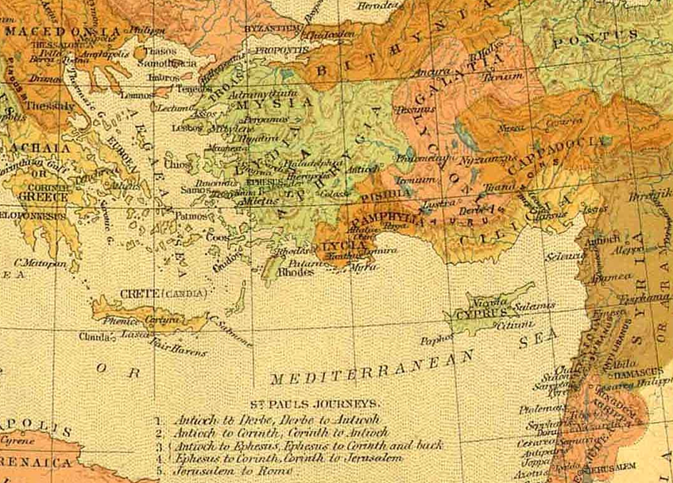
Paul’s journeys
13.4
“they … went down to Seleucia”
14.26
“they sailed to Antioch”
13.4
“they … sailed to Cyprus”
1st missionary
journey
Acts 13-14
13.13
“Paul and his company set sail from Paphos, and came to Perga”
Notes:
And keep in mind also the Pharisaic view that eternal life was in the Law of Moses.
In Jn. 5 Jesus spoke of them searching those scriptures and
“THINKING that in THEM you have eternal life.”
But like a bright light shining under a bed, Law doesn’t remove dirt, law shows where the dirt is.
As Jesus continued in John 5.45:
I don’t need to accuse you, the one that accuses you IS MOSES, on whom YOU SET YOUR HOPE.
As for the Gentiles, recall Pharisees among the disciples demanding Torah compliance for the Gentiles:
Ac.15.5:
“It is necessary to circumcise them, and to charge them to keep the law of Moses.“
In contrast to the Phar. View, which P knew well, Paul declared trust in Christ.

Slide 21
16.13-16
”we”
Paul’s journeys
16.
10-12
“we”
16.40;
17.1
“they”
15.
40-41
16.6-8
“they”
16.3-4
2nd missionary
journey
Acts 15:36-18:22
Notes:
And keep in mind also the Pharisaic view that eternal life was in the Law of Moses.
In Jn. 5 Jesus spoke of them searching those scriptures and
“THINKING that in THEM you have eternal life.”
But like a bright light shining under a bed, Law doesn’t remove dirt, law shows where the dirt is.
As Jesus continued in John 5.45:
I don’t need to accuse you, the one that accuses you IS MOSES, on whom YOU SET YOUR HOPE.
As for the Gentiles, recall Pharisees among the disciples demanding Torah compliance for the Gentiles:
Ac.15.5:
“It is necessary to circumcise them, and to charge them to keep the law of Moses.“
In contrast to the Phar. View, which P knew well, Paul declared trust in Christ.

Slide 22
Paul’s journeys
“we”
from Philippi
“we”
back to Jerusalem
3rd missionary
journey
Acts 18:23-21:16
Notes:
And keep in mind also the Pharisaic view that eternal life was in the Law of Moses.
In Jn. 5 Jesus spoke of them searching those scriptures and
“THINKING that in THEM you have eternal life.”
But like a bright light shining under a bed, Law doesn’t remove dirt, law shows where the dirt is.
As Jesus continued in John 5.45:
I don’t need to accuse you, the one that accuses you IS MOSES, on whom YOU SET YOUR HOPE.
As for the Gentiles, recall Pharisees among the disciples demanding Torah compliance for the Gentiles:
Ac.15.5:
“It is necessary to circumcise them, and to charge them to keep the law of Moses.“
In contrast to the Phar. View, which P knew well, Paul declared trust in Christ.

Slide 23
letters from Paul the prisoner
“we”
from Caesarea,
through storm
& shipwreck,
Then to Rome
journey to Rome
As a prisoner
Acts 27-28:16

Slide 24
details of a first hand witness in the sea voyages in Acts
scott smelser sbsmelser@comcast.net
Notes:
sse

Slide 25
sea voyages in Acts
“they sailed”
“we sailed”
13.4
13.13
14.26
17.15
18.18,19
18.21,22
16.11
20.6
20.13-16
20.38-21.3
21.5-7
chapter 27
scott smelser sbsmelser@comcast.net
Notes:
sse

Slide 26
16.11 “Setting sail therefore from Troas we made a straight course to Samothrace and the day following to Neapolis”
18.21,22“we sailed away from Philippi after the days of the unleavened bread, and came to them to Troas in five days”
20.13-16“But we, going before to the ship, set sail for Asos, there intending to take in Paul: for so he had appointed, intending himself to go by land. And when we met him at Asos we took him in, and came to Mitylene. And sailing from thence, we came the following day over against Chios, the next day we touched at Samos: and the day after, we came to Miletus, for Paul had determined to sail past Ephesus, that he might not have to spend time in Asia, for he was hastening, if it were possible for him, to be at Jerusalem the day of Pentecost.”
20.38-21.3 “They brought him on his way to the ship. And when it came to pass that we were parted from them and set sail, we came with a straight course unto Cos, and the next day unto Rhodes, and from thence unto Patara: and having found a ship crossing over to Phoenicia, we went aboard and set sail, and when we had come in sight of Cyprus, leaving it on the left hand, we sailed unto Tyre, for their the ship was to unlade her burden.”
21.5-7 “they all, with wives and children, brought us on our way… and kneeling down on the beach, we prayed and bade each other farewell; we went on board the ship, but they returned home again. And when we had finished the voyage from Tyre, we arrived at Ptolemais”
sea voyages in Acts
“they sailed”
“we sailed”
13.4 “they sailed to Cyprus”
13.13 “Paul and his company set sail from Paphos and came to Perga”
14.26 “they sailed to Antioch”
17.15 “they that conducted Paul brought him as far as Athens”
18.18,19 “they sailed thence for Syria … they came to Ephesus”
18.21,22“he set sail from Ephesus … landed at Caeserea”
20.13-16“But we, going before to the ship, set sail for Asos, there intending to take in Paul: for so he had appointed, intending himself to go by land. And when we met him at Asos we took him in, and came to Mitylene. And sailing from thence, we came the following day over against Chios, the next day we touched at Samos: and the day after, we came to Miletus, for Paul had determined to sail past Ephesus, that he might not have to spend time in Asia, for he was hastening, if it were possible for him, to be at Jerusalem the day of Pentecost.”
20.38-21.3 “They brought him on his way to the ship. And when it came to pass that we were parted from them and set sail, we came with a straight course unto Cos, and the next day unto Rhodes, and from thence unto Patara: and having found a ship crossing over to Phoenicia, we went aboard and set sail, and when we had come in sight of Cyprus, leaving it on the left hand, we sailed unto Tyre, for their the ship was to unlade her burden.”
21.5-7 “they all, with wives and children, brought us on our way… and kneeling down on the beach, we prayed and bade each other farewell; we went on board the ship, but they returned home again. And when we had finished the voyage from Tyre, we arrived at Ptolemais”
16.11 “Setting sail therefore from Troas we made a straight course to Samothrace and the day following to Neapolis”
20.6 “we sailed away from Philippi after the days of the unleavened bread, and came to them to Troas in five days”
ch. 27!
scott smelser sbsmelser@comcast.net
Notes:
sse

Slide 27
letters from Paul the prisoner
14 There we found brothers and were invited to stay with them for seven days. And so we came to Rome. 15 And the brothers there, when they heard about us, came as far as the Forum of Appius and Three Taverns to meet us. On seeing them, Paul thanked God and took courage. 16 And when we came into Rome, Paul was allowed to stay by himself, with the soldier who guarded him.
9 Since much time had passed, and the voyage was now dangerous because even the Fast was already over, Paul advised them, 10 saying, "Sirs, I perceive that the voyage will be with injury and much loss, not only of the cargo and the ship, but also of our lives." 11 But the centurion paid more attention to the pilot and to the owner of the ship than to what Paul said. 12 And because the harbor was not suitable to spend the winter in, the majority decided to put out to sea from there, on the chance that somehow they could reach Phoenix, a harbor of Crete, facing both southwest and northwest, and spend the winter there.
4 And putting out to sea from there we sailed under the lee of Cyprus, because the winds were against us. 5 And when we had sailed across the open sea along the coast of Cilicia and Pamphylia, we came to Myra in Lycia. 6 There the centurion found a ship of Alexandria sailing for Italy and put us on board.
7 We sailed slowly for a number of days and arrived with difficulty off Cnidus, and as the wind did not allow us to go farther, we sailed under the lee of Crete off Salmone. 8 Coasting along it with difficulty, we came to a place called Fair Havens, near which was the city of Lasea.
11 After three months we set sail in a ship that had wintered in the island, a ship of Alexandria, with the twin gods as a figurehead. 12 Putting in at Syracuse, we stayed there for three days. 13 And from there we made a circuit and arrived at Rhegium. And after one day a south wind sprang up, and on the second day we came to Puteoli.
21 Since they had been without food for a long time, Paul stood up among them and said, "Men, you should have listened to me and not have set sail from Crete and incurred this injury and loss. 22 Yet now I urge you to take heart, for there will be no loss of life among you, but only of the ship. 23 For this very night there stood before me an angel of the God to whom I belong and whom I worship, 24 and he said, 'Do not be afraid, Paul; you must stand before Caesar. And behold, God has granted you all those who sail with you.' 25 So take heart, men, for I have faith in God that it will be exactly as I have been told. 26 But we must run aground on some island."
EVENTS ON THE ISLE OF MALTA 28.1-10
20 When neither sun nor stars appeared for many days, and no small tempest lay on us, all hope of our being saved was at last abandoned.
39 Now when it was day, they did not recognize the land, but they noticed a bay with a beach, on which they planned if possible to run the ship ashore. 40 So they cast off the anchors and left them in the sea, at the same time loosening the ropes that tied the rudders. Then hoisting the foresail to the wind they made for the beach. 41 But striking a reef, they ran the vessel aground. The bow stuck and remained immovable, and the stern was being broken up by the surf.
42 The soldiers' plan was to kill the prisoners, lest any should swim away and escape. 43 But the centurion, wishing to save Paul, kept them from carrying out their plan. He ordered those who could swim to jump overboard first and make for the land, 44 and the rest on planks or on pieces of the ship. And so it was that all were brought safely to land.
27 When the fourteenth night had come, as we were being driven across the Adriatic Sea, about midnight the sailors suspected that they were nearing land. 28 So they took a sounding and found twenty fathoms. A little farther on they took a sounding again and found fifteen fathoms. 29 And fearing that we might run on the rocks, they let down four anchors from the stern and prayed for day to come.
33 As day was about to dawn, Paul urged them all to take some food, saying, "Today is the fourteenth day that you have continued in suspense and without food, having taken nothing. 34 Therefore I urge you to take some food. For it will give you strength, for not a hair is to perish from the head of any of you." 35 And when he had said these things, he took bread, and giving thanks to God in the presence of all he broke it and began to eat. 36 Then they all were encouraged and ate some food themselves. 37 (We were in all 276 persons in the ship.) 38 And when they had eaten enough, they lightened the ship, throwing out the wheat into the sea.
30 And as the sailors were seeking to escape from the ship, and had lowered the ship's boat into the sea under pretense of laying out anchors from the bow, 31 Paul said to the centurion and the soldiers, "Unless these men stay in the ship, you cannot be saved." 32 Then the soldiers cut away the ropes of the ship's boat and let it go.
3 The next day we put in at Sidon. And Julius treated Paul kindly and gave him leave to go to his friends and be cared for.
16 Running under the lee of a small island called Cauda, we managed with difficulty to secure the ship's boat. 17 After hoisting it up, they used supports to undergird the ship. Then, fearing that they would run aground on the Syrtis, they lowered the gear, and thus they were driven along. 18 Since we were violently storm-tossed, they began the next day to jettison the cargo. 19 And on the third day they threw the ship's tackle overboard with their own hands.
13 Now when the south wind blew gently, supposing that they had obtained their purpose, they weighed anchor and sailed along Crete, close to the shore. 14 But soon a tempestuous wind, called the northeaster, struck down from the land. 15 And when the ship was caught and could not face the wind, we gave way to it and were driven along.
1 And when it was decided that we should sail for Italy, they delivered Paul and some other prisoners to a centurion of the Augustan Cohort named Julius. 2 And embarking in a ship of Adramyttium, which was about to sail to the ports along the coast of Asia, we put to sea, accompanied by Aristarchus, a Macedonian from Thessalonica.
journey to Rome
As a prisoner
Acts 27-28:16
scott smelser sbsmelser@comcast.net

Slide 28
SO: Two years after travelling with Paul from Philippi to Jerusalem (when Paul was free), our author now travels with Paul from Caesarea to Rome (while Paul was a prisoner). From this, we establish 2 points:
Which leads to this Q:
1. our author is close associate of Paul
2. our author comes with Paul to Rome
Who was with Paul in Rome?

Slide 29
Luke / Acts evidence for authorship & date
historic
attribution
INTERNAL EVIDENCE:
ACTS
LUKE
INTERNAL EVIDENCE: prison voyage & epistles

Slide 30
letters from Paul the prisoner
Greetings to… > Greetings from…<
Ephesians
Philippians
2 Timothy
Colossians
Philemon
“we”
From Caeserea,
through the storm
and shipwreck, & to Rome
journey to Rome
As a prisoner
Acts 27-28:16
scott smelser sbsmelser@comcast.net

Slide 31
x
Ephesians
Philippians
2 Timothy
Colossians
Tychicus
Philemon
Timothy
Tychicus
Timothy
Demas
Epaphroditus
Onesimus
Onesimus
Crescens
Aristarchus
Epaphras
Titus
Mark
Mark
Luke
Justus
Aristarchus
Tychicus
Epaphras
Demas
Eubulus
Pudens
Linus
Claudia
Luke
Luke
Demas
Timothy
scott smelser sbsmelser@comcast.net

Slide 32
x
evidence points TO
evidence points AWAY FROM
evidence ELIMINATES
+ ext.
test.
“Luke, the beloved physician”
Col. 4.14
3x
Tychicus
Timothy
Tychicus
Timothy
Demas
Epaphroditus
Onesimus
Onesimus
Crescens
“only Luke is with me” 2Tim.4.11
Aristarchus
Epaphras
Titus
2Tm.4.10
A.15.36-16.11
Mark
Mark
Luke
Php. 2, 4
Luke 4.15,
Acts1.19?
(Col. 4.11,14)
Justus
Aristarchus
Tychicus
Phm.10,11
Epaphras
Demas
Eubulus
Pudens
Linus
Claudia
Luke
Luke
Col. 1.7,4.12
Acts 20.4
Demas
Timothy
scott smelser sbsmelser@comcast.net

Slide 33
gospel
epistles
acts
of the apostles
by
Luke
by
Luke
scott smelser sbsmelser@comcast.net

Slide 34
side notes & “authorities”…

Slide 35
https://www.jstor.org/stable/3137396?seq=7#metadata_info_tab_contents
MEDICAL LANGUAGE IN LUKE ?
Medical Language argument adv. by Hobart (1882) Knowling, etc.
"Efforts to argue that the Third Gospel demonstrates that its author was a doctor have been abandoned today… Cadbury later refuted these claims by proving that Luke showed no more “medical” language than other educated writers of his day.11...” Black, M. C. (1996). Luke. College Press NIV commentary. Joplin, Mo.: College Press Pub.
"Colossians 4:14 refers to Luke as a doctor. In 1882, Hobart tried to bolster this connection by indicating all the technical verbal evidence for Luke’s vocation. Despite the wealth of references Hobart gathered, the case was rendered ambiguous by the work of Cadbury (1926), who showed that almost all of the alleged technical medical vocabulary appeared in everyday Greek documents such as the LXX, Josephus, Lucian, and Plutarch. This meant that the language could have come from a literate person within any vocation. Cadbury’s work does not, however, deny that Luke could have been a doctor, but only that the vocabulary of these books does not guarantee that he was one." Bock, D. L. (1994). Luke Vol. 1: 1:1-9:50. Baker exegetical commentary on the New Testament (7). Grand Rapids, Mich.: Baker Books -footnotes via Wikipedia art. “Authorship of Luke-Acts
Medical Language argument rebuttal by Cadbury (1926)

Slide 36
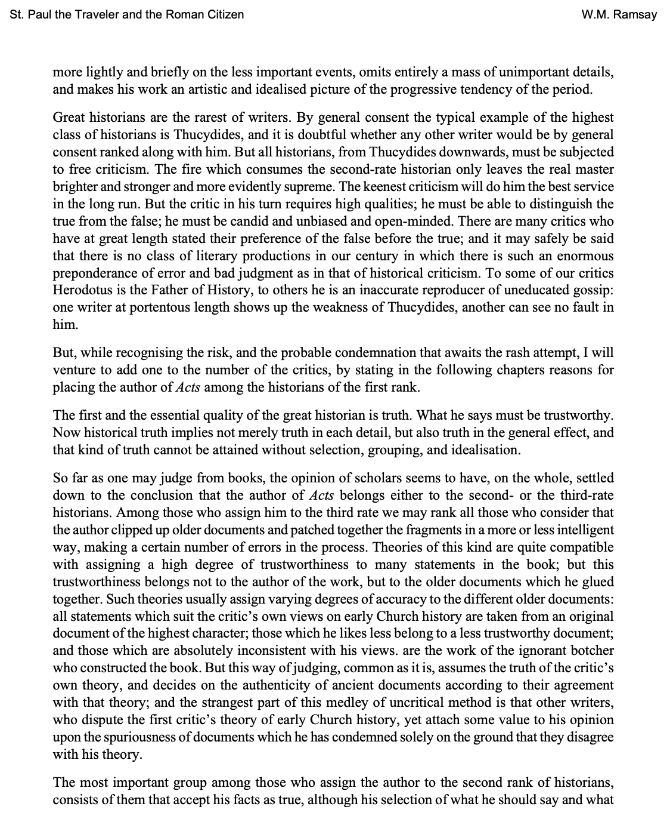
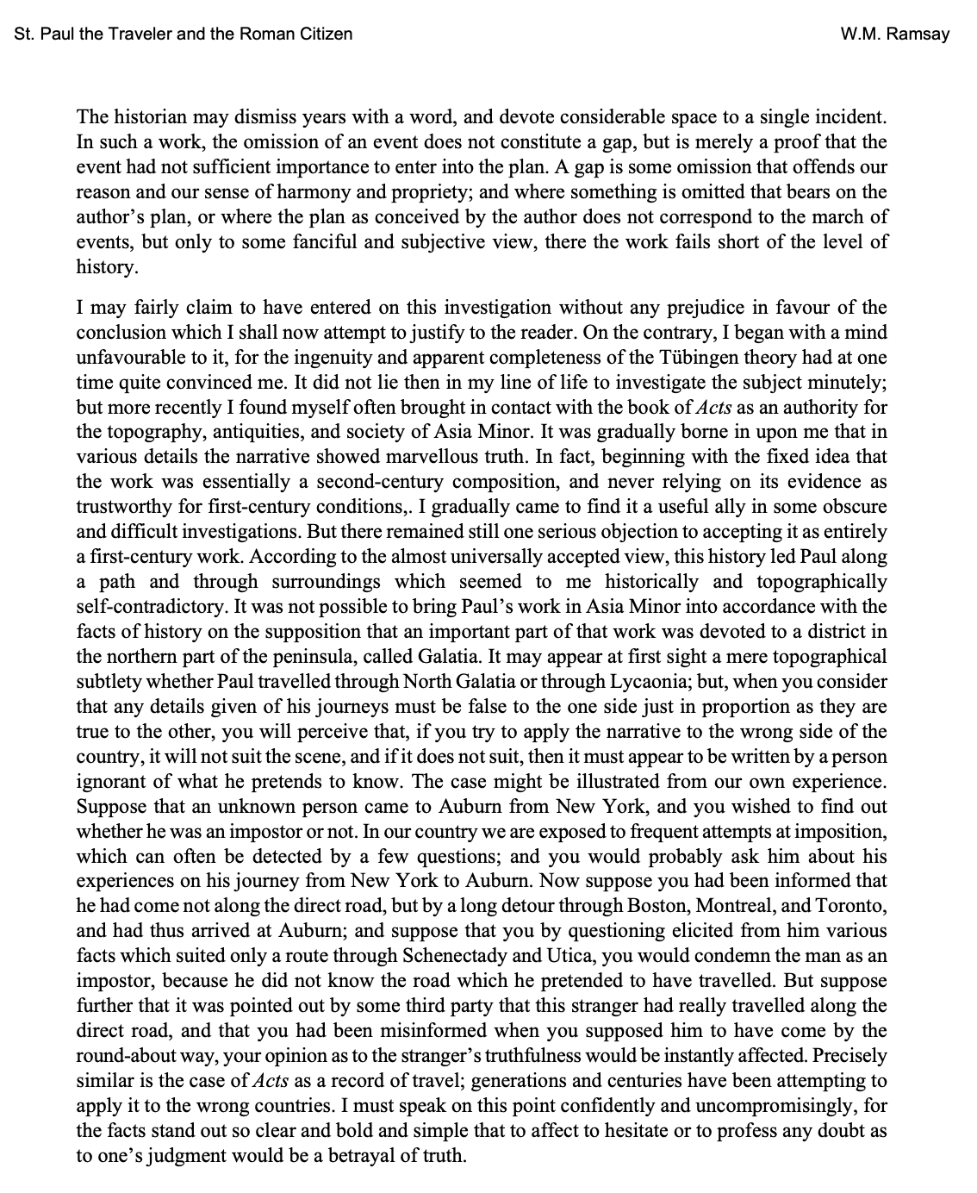
Sir William Mitchell Ramsay
(1851 - 1939)
New Testament scholar and archeaologist.
first Professor of Classical Archaeology at Oxford
pioneered the study of antiquity in what is today western Turkey
Greece and Turkey remained the focus of Ramsay's research
known for his expertise in the historic geography and topography of Asia Minor and of its political, social, cultural and religious history. wikipedia.com

Slide 37
Sir William Mitchell Ramsay St. Paul the Traveller and the Roman Citizen 1895
scott smelser sbsmelser@comcast.net

Slide 38
Sir William Mitchell Ramsay St. Paul the Traveller and the Roman Citizen 1895
scott smelser sbsmelser@comcast.net

Slide 39
Luke / Acts evidence for authorship & date
Historic
Attribution
INTERNAL EVIDENCE: ACTS
LUKE
COMPARISON: prison voyage & epistles
Luke: shortly prior to Acts ACTS: ca. 62/63

Slide 40
TWO KEY ANCHOR DATES in ACTS
PAUL ARRIVES
AT CORINTH
c. 50 AD
[Gallio / Dephi inscr.]
PAUL APPEALS
TO CAESAR
c. 59 AD
[Felix > Festus trans.]
scott smelser sbsmelser@comcast.net
Notes:
And keep in mind also the Pharisaic view that eternal life was in the Law of Moses.
In Jn. 5 Jesus spoke of them searching those scriptures and
“THINKING that in THEM you have eternal life.”
But like a bright light shining under a bed, Law doesn’t remove dirt, law shows where the dirt is.
As Jesus continued in John 5.45:
I don’t need to accuse you, the one that accuses you IS MOSES, on whom YOU SET YOUR HOPE.
As for the Gentiles, recall Pharisees among the disciples demanding Torah compliance for the Gentiles:
Ac.15.5:
“It is necessary to circumcise them, and to charge them to keep the law of Moses.“
In contrast to the Phar. View, which P knew well, Paul declared trust in Christ.

Slide 41
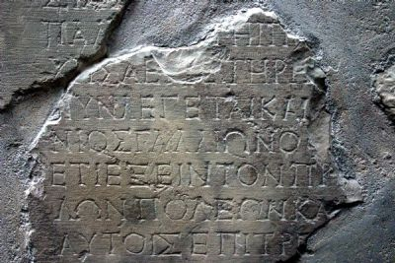
Part way through Paul’s 1.5 yrs @ Corinth: “he stayed a year and six months… But when Gallio was proconsul of Achaia, the Jews …brought him before the tribunal” Act 18:11-12 ESV
From the Delphi inscription,
we can date Gallio’s arrival as Proconsul to Corinth:
c. 51 AD
This places the date of Paul’s arrival to Corinth to:
c. 50 AD
image courtesy of www.HolyLandPhotos.org

Slide 42
“When two years had elapsed, Felix was succeeded by Porcius Festus. And desiring to do the Jews a favor, Felix left Paul in prison.” Acts 23.27
“I appeal to Caesar”
Acts 25.11
59 AD (+/-1)
minted by Felix
date LC (Nero. yr 3) =
56/57 A.D
Yevlem - CC BY 3.0
minted by Festus date LE (Nero. yr 5) =
58/59 A.D
52-~59
~59 >
scott smelser sbsmelser@comcast.net

Slide 43
“When two years had elapsed, Felix was succeeded by Porcius Festus. And desiring to do the Jews a favor, Felix left Paul in prison.” Acts 23.27
“I appeal to Caesar”
Acts 25.11
P R I S O N V O Y A G E
And when we came into Rome, Paul was allowed to stay by himself, with the soldier who guarded him. ...
He lived there
TWO WHOLE YEARS at his own expense, and welcomed all who came to him, 31 proclaiming the kingdom of God and teaching about the Lord Jesus Christ with all boldness and without hindrance. [Act 28:16, 30-31 ESV]
59 AD (+/-1)
minted by Felix
date LC (Nero. yr 3) =
56/57 A.D
Yevlem - CC BY 3.0
minted by Festus date LE (Nero. yr 5) =
58/59 A.D
52-~59
~59 >
scott smelser sbsmelser@comcast.net

Slide 44
Luke / Acts evidence for authorship & date
Historic
Attribution
INTERNAL EVIDENCE: ACTS
LUKE
COMPARISON: prison voyage & epistles
contemporary w/ Paul ~49/60 AD (est. above)
Luke: shortly prior to Acts ACTS: ca. 62/63

Slide 45
Luke / Acts evidence for authorship & date
Historic
Attribution
INTERNAL EVIDENCE: ACTS
LUKE
COMPARISON: prison voyage & epistles
contemporary w/ Paul ~49/60 AD (est. above)
Luke: shortly prior to Acts ACTS: ca. 62/63
terminus of the text

Slide 46
DATING ACTS?
Ends ca. 62 AD,
with Paul still a prisoner. Why stop there?

Slide 47
Reasons for supporting a date for Luke in the early 60’s:
1. The ending of the book of Acts
LUKE
VOL 1
ACTS
VOL 2
c.34 years
c. 32 years
?
?
?

Slide 48
COMPOSE
TO A CULMINATING EVENT
COMPOSE
TO AN UNFINSISHED POINT IN HISTORY
GOSPEL OF LUKE

Slide 49
Luke / Acts evidence for authorship & date
Historic
Attribution
INTERNAL EVIDENCE: ACTS
LUKE
COMPARISON: prison voyage & epistles
contemporary w/ Paul ~49/60 AD (est. above)
Luke: shortly prior to Acts ACTS: ca. 62/63
terminus of the text
persecution status at the time of writing: J. < > R.

Slide 50
3rd reason for supporting a date for Luke in the early 60’s:
Persecution is a major theme in Acts
At that time, and relative to persecution, what are the relations between
the early church and:
JEWISH LEADERS
ROMAN LEADERS

Slide 51
THE Centurions in Luke/Acts
Lk 7 worthy / humble/ built our synagogue/ great faith
Lk 23 “Certainly this man was innocent”
Ac 10 Cornelius: devout / generous / well respected
Ac 21 Roman centurions help rescue Paul from mob
Ac 22 respected Paul’s right as a Roman
Ac 23 took Paul’s nephew & report to the tribune
Ac 23 centurions take Paul to safety in Caesarea
Ac 24 at C., charged to give Paul some freedom & visitors
Ac 27 Julius/ treated Paul kindly (3) preserves his life (43)
And of course, to escape the threat of the Jews,
Paul appeals to Caesar
scott smelser sbsmelser@comcast.net

Slide 52
64 AD Rome burns- and things turn vicious

Slide 53
TACITUS Roman Senator &
Historian
ANNALS ca.
105-~120 AD
ON NERO & THE FIRE OF ROME
64 AD
A disaster followed, whether accidental or treacherously contrived by the emperor, is uncertain, as authors have given both accounts, worse, however, and more dreadful than any which have ever happened to this city by the violence of fire…
a rumour had gone forth everywhere that, at the very time when the city was in flames, the emperor appeared on a private stage and sang of the destruction of Troy …
At last, after five days, an end was put to the conflagration -Annals 15.38-40

Slide 54
TACITUS Roman Senator &
Historian
ANNALS ca.
105-~120 AD
ON NERO & THE FIRE OF ROME
64 AD
all human efforts, all the lavish gifts of the emperor, and the propitiations of the gods, did not banish the sinister belief that the conflagration was the result of an order. Consequently, to get rid of the report, Nero fastened the guilt and inflicted the most exquisite tortures on a class hated for their abominations, called Christians by the populace. Christus, from whom the name had its origin, suffered the extreme penalty during the reign of Tiberius at the hands of one of our procurators, Pontius Pilatus, and a most mischievous superstition, thus checked for the moment, again broke out not only in Judaea, the first source of the evil, but even in Rome, where all things hideous and shameful from every part of the world find their centre and become popular. -Annals 15.44

Slide 55
TACITUS Roman Senator &
Historian
ANNALS ca.
105-~120 AD
ON NERO & THE FIRE OF ROME
64 AD
Accordingly, an arrest was first made of all who pleaded guilty; then, upon their information, an immense multitude was convicted, not so much of the crime of firing the city, as of hatred against mankind. Mockery of every sort was added to their deaths. Covered with the skins of beasts, they were torn by dogs and perished, or were nailed to crosses, or were doomed to the flames and burnt, to serve as a nightly illumination, when daylight had expired. Nero offered his gardens for the spectacle, and was exhibiting a show in the circus, while he mingled with the people in the dress of a charioteer or stood aloft on a car. Hence, even for criminals who deserved extreme and exemplary punishment, there arose a feeling of compassion; for it was not, as it seemed, for the public good, but to glut one man's cruelty, that they were being destroyed. -Annals 15.44

Slide 56
supporting a date for Luke in the early 60’s:
The status of persecution
(as seen in Acts),
is almost always instigated
from Jewish opponents. Other an occasional
breech of rights (Ac.16)
or desire for a bribe (Ac. 24), the Romans in Acts are generally a source of stability, law & order, and relative security. (cf. also Rom. 13) Though cf. also 1 Ptr.; Php. 1&2
ACTS
scott smelser sbsmelser@comcast.net

Slide 57
a.) contemporary with Paul in ca. 49 – 60
DATING ACTS
b.) ends ca. 62 AD
ca. 62 (63) AD
c.) pers. status at time of writing: Jewish hostility, Roman stability
GOSPEL OF LUKE
was prior
Appears to be prior to Nero’s persecution in Rome.

Slide 58
Luke / Acts evidence for authorship & proposed date
Historic
Attribution
INTERNAL EVIDENCE: ACTS
LUKE
COMPARISON: prison voyage & epistles
contemporary w/ Paul ~49/60 AD (est. above)
Luke: shortly prior to Acts ACTS: ca. 62/63
terminus of the text
persecution status at the time of writing: J. < > R.

Slide 59
Additional notes: THEOPHILUS

Slide 60
Classical Numismatic Group, Inc. http://www.cngcoins.com CC BY-SA 3.0
Theophilus: the name
“Lover of God”
2. Also a known Greek name
Theophilus Coin / ca. 100 BC (+/- 30yrs)
Minor Indo-Greek King (c. 130 BCE or 90 BCE)
Greek Legend: ΒΑΣΙΛΕΩΣ ΔΙΚΑΙΟΥ ΘΕΟΦΙΛΟΥ
"Of Fair/Just King Theophilos".
scott smelser sbsmelser@comcast.net

Slide 61
Theophilus: the man
cf. κρατιστος ( 4x ) “MOST EXCELLENT THEOPHILUS” Luke > Theophilus (Luke 1:3)
“MOST EXCELLENT GOVERNOR FELIX, GREETINGS”
Claudius Lysias > Governor (Ac.23.26) “MOST EXCELLENT FELIX, WITH ALL THANKFULNESS”
Tertullus > Governor (Ac. 24.3) "MOST EXCELLENT FESTUS” Paul > Governor (Ac. 26.25) -NASB
Proposal: Theophilus a governing official in Macedonia
a.) In the 1st “we” section, we last see the author in Philippi, Macedonia. In the 2nd “we” section, we first see the author in Philippi, Macedonia. Luke may, therefore, have spent considerable time in Macedonia.
b.) The political capital of the Macedonian region is Thessalonica.
c.) In the narrating of the Thessalonian uprising, the non-introductory reference to Jason (who is neither the only one seized, nor the only one bonded), stands in stark contrast to the typical narrative introductions in Acts (cf. Annanias, Simon the Tanner, Elymas, Titus Justus, etc. – see next slide).
Jason, a resident of the capital city, and a rather minor character within the book of Acts as a whole, seems here to need no introduction. This may point to Thessalonica, the Macedonian seat of government in Macedonia, being also the city of Theophilus.
scott smelser sbsmelser@comcast.net

Slide 62
typical narrative character intros in Acts (usually with τις G5100 )
OHTER INTROS W/O “τις” [G5100]:
And a certain[G5100] man lame from his mother's womb was carried, whom they laid daily at the gate of the temple …
But a certain[G5100] man named Ananias, with Sapphira his wife, sold a possession ...
Then stood there up one[G5100] in the council, a Pharisee, named Gamaliel, a doctor of the law, had in reputation among all the people…
But there was a certain[G5100] man, called Simon, which beforetime in the same city used sorcery, and bewitched the people of Samaria…
And there was a certain[G5100] disciple at Damascus, named Ananias; and to him said the Lord in a vision ...
And there he found a certain[G5100] man named Aeneas, which had kept his bed eight years, and was sick of the palsy. ...
there was at Joppa a certain[G5100] disciple named Tabitha, which by interpretation is called Dorcas: this woman was full of good works …
And it came to pass, that he tarried many days in Joppa with one[G5100] Simon a tanner…
There was a certain[G5100] man in Caesarea called Cornelius, a centurion of the band called the Italian [band]…
there were in the church … at Antioch certain[G5100] prophets and teachers; as Barnabas, and Simeon that was called Niger, and Lucius …
they found a certain[G5100] sorcerer, a false prophet, a Jew, whose name [was] Barjesus…
And there sat a certain[G5100] man at Lystra, impotent in his feet, being a cripple from his mother's womb, who never had walked….
to Derbe and Lystra: and, behold, a certain[G5100] disciple was there, named Timotheus, the son of a certain[G5100] woman… a Jewess…
a certain[G5100] woman named Lydia, a seller of purple, of the city of Thyatira…
a certain[G5100] damsel possessed with a spirit of divination met us, which brought her masters much gain by soothsaying…
Then certain[G5100] philosophers of the Epicureans, and of the Stoicks, encountered him. And some[G5100] said…
certain[G5100] men clave unto him, and believed: among the which [was] Dionysius the Areopagite, and a woman named Damaris…
And found a certain[G5100] Jew named Aquila, born in Pontus, lately come from Italy, with his wife Priscilla…
he… entered into a certain[G5100] [man's] house, named Justus, [one] that worshipped God, whose house joined hard to the synagogue...
And a certain[G5100] Jew named Apollos, born at Alexandria, an eloquent man, [and] mighty in the scriptures, came to Ephesus…
a certain[G5100] [man] named Demetrius, a silversmith, which made silver shrines for Diana, brought no small gain unto the craftsmen…
there sat in a window a certain[G5100] young man named Eutychus, being fallen into a deep sleep:
there came down from Judaea a certain[G5100] prophet, named Agabus. ...
also [certain] of the disciples of Caesarea, and … one[G5100] Mnason of Cyprus, an old disciple, with whom we should lodge...
And one[G5100] Ananias, a devout man according to the law, having a good report of all the Jews which dwelt [there]…
and [with] a certain[G5100] orator [named] Tertullus, who informed the governor against Paul. [Act 24:1 KJV]
And Joses, who by the apostles was surnamed Barnabas, (which is, being interpreted, The son of consolation,) a Levite, [and] of the country of Cyprus, 37 Having land, sold [it], and brought the money, and laid [it] at the apostles' feet.
58 And cast [him] out of the city, and stoned [him]: and the witnesses laid down their clothes at a young man's feet, whose name was Saul.
And Crispus, the chief ruler of the synagogue, believed on the Lord with all his house; and many of the Corinthians hearing believed, and were baptized.
scott smelser sbsmelser@comcast.net

Slide 63
COMPARE WITH THE PRECEDING THIS NARRATIVE WITH JASON
And some[G5100] of them believed,
and consorted with Paul and Silas;
and of the devout Greeks a great multitude,
and of the chief women not a few.
But the Jews which believed not,
moved with envy, took unto them
certain[G5100] lewd fellows of the baser sort,
and gathered a company, and set all the city on an uproar,
and assaulted the house of Jason,
and sought to bring them out to the people.
And when they found them not, they drew Jason
and certain[G5100] brethren
unto the rulers of the city,
crying, These that have turned the world upside down
are come hither also; Whom Jason hath received:
and these all do contrary to the decrees of Caesar, saying that there is another king, [one] Jesus. And they troubled the people and the rulers of the city,
when they heard these things.
And when they had taken security of Jason, and of the other, they let them go.
“τις” – certain of them, here unnamed
“τις” – certain, here unnamed
NOT: “τις” – a certain… NOT: the house of a disciple named
scott smelser sbsmelser@comcast.net

Slide 64
Additional notes: epistle references to government: submission, the general and desired role of justice, the potential of injustice

Slide 65
Rom. 13 Let every person be subject to the governing authorities… For rulers are not a terror to good conduct, but to bad. Would you have no fear of the one who is in authority? Then do what is good, and you will receive his approval... But if you do wrong, be afraid, for he does not bear the sword in vain. For he is the servant of God, an avenger who carries out God's wrath on the wrongdoer. [Rom 13:1, 3-4 ESV]
1Peter 2: 12 Keep your conduct among the Gentiles honorable, so that when they speak against you as evildoers, they may see your good deeds and glorify God on the day of visitation. 13 Be subject for the Lord's sake to every human institution, whether it be to the emperor as supreme, 14 or to governors as sent by him to punish those who do evil and to praise those who do good. [1Pe 2:12-14 ESV] 1Peter 3: “Do not repay evil for evil or reviling for reviling, but on the contrary, bless, for to this you were called, that you may obtain a blessing. For "Whoever desires to love life and see good days, let him keep his tongue from evil and his lips from speaking deceit;
Let him turn away from evil and do good; let him seek peace and pursue it.
For the eyes of the Lord are on the righteous, and his ears are open to their prayer.
But the face of the Lord is against those who do evil."
Now who is there to harm you if you are zealous for what is good?
But even if you should suffer for righteousness' sake,
you will be blessed… For it is better to suffer for doing good,
if that should be God's will, than for doing evil.
For Christ also suffered once for sins, the righteous for the unrighteous…”
1Peter 4: 15 But let none of you suffer as a murderer or a thief or an evildoer or as a meddler. 16 Yet if anyone suffers as a Christian, let him not be ashamed, but let him glorify God in that name. [1Pe 4:15-16 ESV]
Cf. 18 Servants, be subject to your masters with all respect, not only to the good and gentle but also to the unjust. [1Pe 2:18 ESV]
Php. 1: expectation of release
Php. 2: realization that that fate could be execution

