Slide 1
1 PETER 3:15
“be ready always to give answer
to every man that asks you
a reason concerning
the hope that lies within you”

Slide 2
1. "DID JESUS EXIST?" a rebuttal of Mythicist claims 2. "WHAT ABOUT THE 'LOST GOSPELS’?’” a look at the gnostic texts 3. “AREN'T THE GOSPELS JUST LATER LEGENDS?” est. the gospel in the earliest accepted texts 4. HISTORICAL EVIDENCE ON LUKE-ACTS establishing authorship & proposed date
5. THE RESURRECTION OF CHRIST and the testimony from Saul of Tarsus
REBUTTALS
REASONS

Slide 3
1. UNDERSTAND A CRITIC’S ARGUMENT 3. BACKUP TO A COMMON POINT 2. ANSWER & GIVE A REASON FOR YOUR HOPE
x
GOAL WHEN ADDRESSING A CRITIC’S ARGUMENT

Slide 4
The gospels just legends from later times.
None of them were written by eye witnesses.
The early texts
say almost nothing about the stories found in later the gospels.

Slide 5
The gospels just legends from later times.
None of them were written by eye witnesses.
The earlier
letters of Paul
(7 authentic ones) don’t tell the stories found in the gospels.

Slide 6
https://www.youtube.com/watch?v=WUYRoYl7i6U

Slide 7
Rom. Gal.
Php.
1 Cor.
2 Cor. 1 Thess.
Philmn.
Did Jesus Even Exist? | Richard Carrier https://www.youtube.com/watch?v=WUYRoYl7i6U

Slide 8
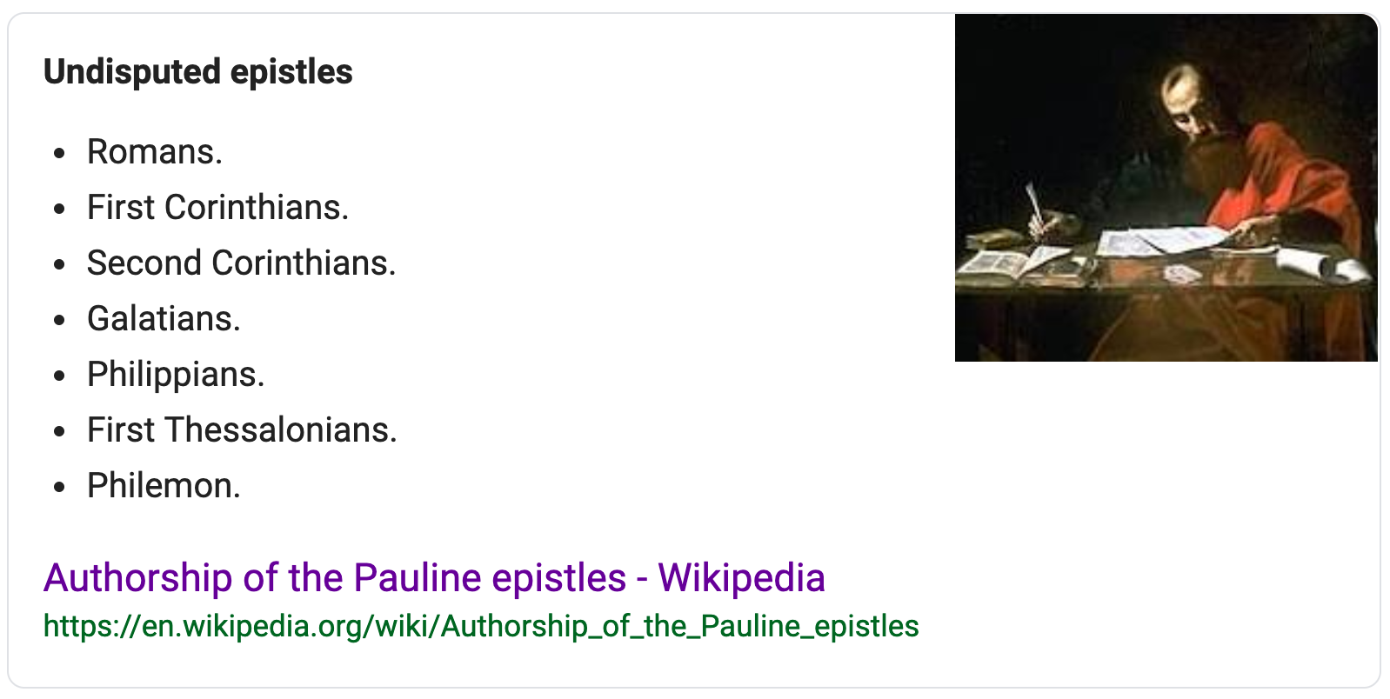
Undisputed letters of Paul as recognized by historians/critics:
(Including agnositcs, atheists, etc.)

Slide 9
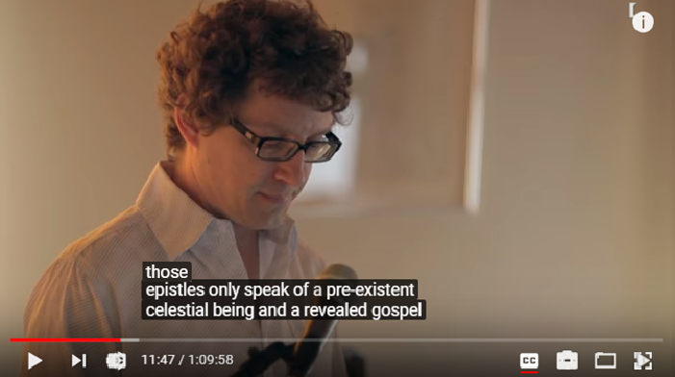
Did Jesus Even Exist? | Richard Carrier https://www.youtube.com/watch?v=WUYRoYl7i6U

Slide 10
So the critic says the gospels are not early… but these 7 letters of Paul are….
Rom. Gal.
Php.
1 Cor.
2 Cor. 1 Thess.
Philmn.

Slide 11
using only
the early and
critic-accepted (as to date / authorship)
letters of Paul
EXERCISE:
REBUILD
THE
BASIC
GOSPEL

Slide 12
FAMILY Born of Mary (a virgin) Descendant of King David F: Joseph / Br: James, Joseph, Simon, Judas Bethlehem / Nazareth
INTRO: John the Baptist
MINISTRY : Galilee / Samaria/ Judea EXTENSIVE TEACHING (sermons, parables) EXTENSIVE MIRACLES (signs, healings, etc.) 12 Apostles (Peter, John, etc.)
EVENTS SURROUNDING HIS DEATH & RES. Enters Jerusalem Opposed by Jewish Leaders Betrayal by Judas Est. the Lord’s Supper Arrested & Tried before High Priest Brought to Pilate & Herod Crucified Buried Rose on the 1st day Appeared to disciples Ascended to the Father
(Gal. 4.4?)
Rom.1.3
1Cor. 9.5
AC. 22.28
?
Gal. 1.19
AC. 13.24
and if we add Paul’s speeches ( Acts)
AC. 20.35
1C. 7.10
1C.11.23
(R.15.19, 2C 12.12)
1C.15.5
From THE GOSPELS
From: ROM / 1&2 COR / GAL / PHILIP / 1TH / PHLM
Gal.1-2
1C.1; 15.5
1Th2.14,15
1C.11.23
1C.11.23-25
AC. 13.28
1Th2.14,15
1C.2.2; 1.18
Php.2.8
Gal.3.13
1C.15.4
Rm.1.4
1C.15;16.1
1C.15
Php.2.9
Rom8.34

Slide 13
and further still:
EARLY ACCOUNTS
1 Cor. 15 is written about 55 AD
(only about
25 yrs after
the cross).
And going further still: From Gal. 1:15-23
we see Paul was preaching the gospel shortly after his conversion (see 1:23)-
(so within a fews yrs of the cross)
In it, he reminds them (1C.15.1ff)
of what he had preached c. 50 AD
(only c. 20 yrs.
after the cross).
A later generation legend? Paul’s Gospel is an EARLY message.
(for timing: see Gallio inscription at 3minutebiblestudy.com
on Archaeology and cf. Gallio in office: Acts 18.12].

Slide 14
The gospels just legends from later times.
None of them were written by eye witnesses.
The early texts
say almost nothing about the stories found in later the gospels.

Slide 15
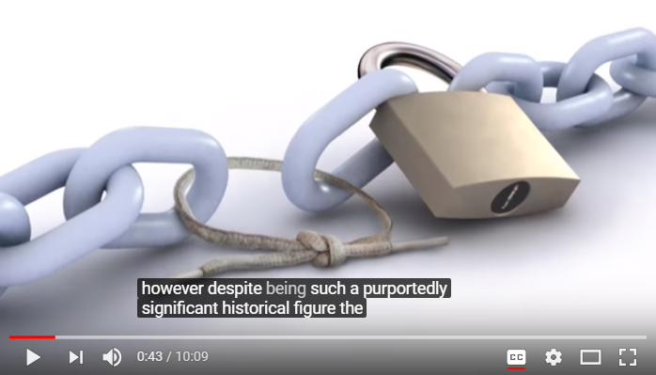
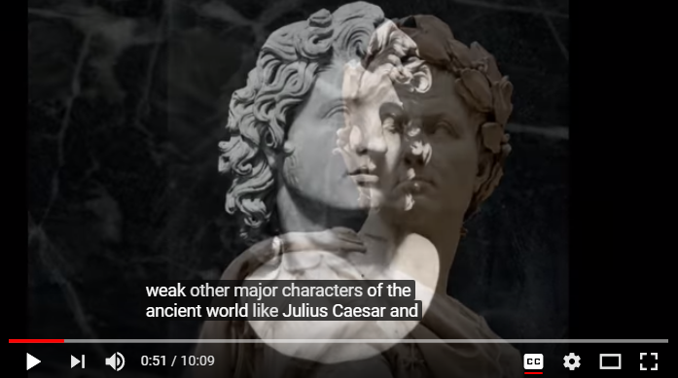
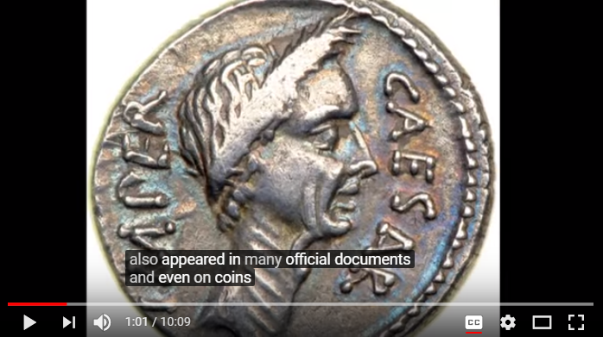

Slide 16
Alexander the Great

Slide 17
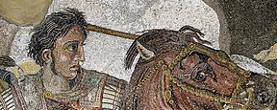
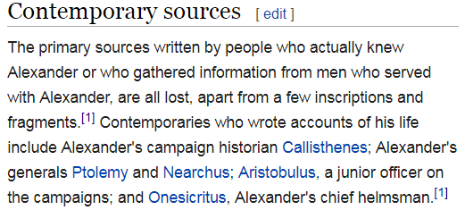
2nd Cent. AD
2nd Cent. AD
1st Cent. BC
1st Cent. AD
145 AD; c.200AD 395 AD
[ abr. of Trogus late 1c BC ]
mss.: 1200 & 1400’s
chief mss.: 10th/11th cent. AD
oldest ms.:
10th cent. AD
oldest ms.:
9th cent.
many mss. from the middle ages
https://www.loebclassics.com/view/LCL236/1976/pb_LCL236.xv.xml
Epitome of the Philippic History of Pompeius Trogus: Books 11-12 ..., Volume 1 By Marcus Junianus Justinus

Slide 18
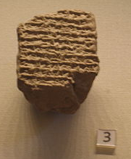
Plutarch
Plutarch
Death noted in clay Bab. Astron.
Diary (Brit. Mus.)
Arrian
Arrian
Diodorus
Diodorus
Curtius
Curtius
Justin
Justin’s Abr. of Trogus 200 mss from the “middle ages” (could not find spec. dates)
TROGUS
A
| | | | | | | | |
| | | | | | | | |
300 200 100 /\ 100 200 300 400 500 600 700 800 900 1000 1100 1200 1300 1400 1500

Slide 19
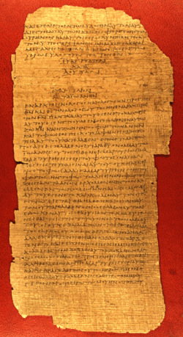
P 75 Luke
3:18-
24:53 &John
175-225 AD
Though a few have proposed dates of end of 3rd or 4th cent.
My est. date based on finishing point of Acts & other detail, (contact me for more info on Luke)
LUKE
P 75
1 Thess
1 Cor.
J
| | | | | | | | |
| | | | | | | | |
| | | | | | | | |
300 200 100 /\ 100 200 300 400 500 600 700 800 900 1000 1100 1200 1300 1400 1500

Slide 20
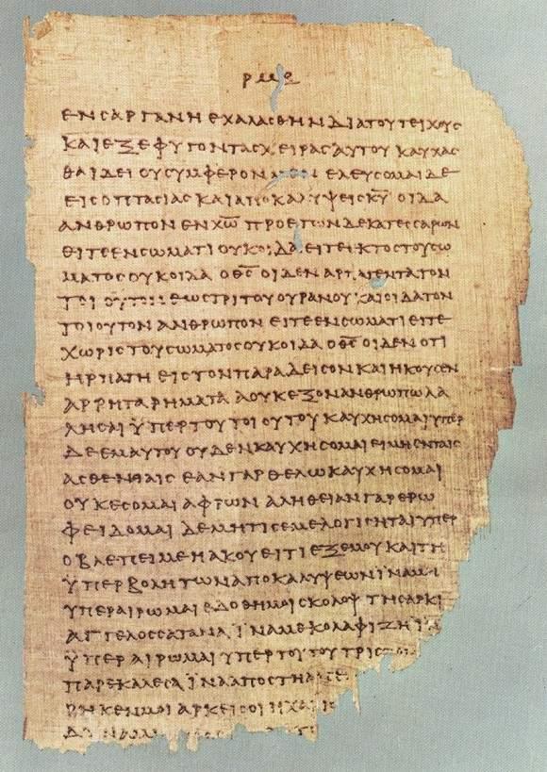
by permission:
Institute For Antiquity And Christianity, Claremont, California
P 46
1Cor.
1Thes.
& other
Epistles
175-225 AD
LUKE
1 Thess
P 46
1 Cor.
J
| | | | | | | | |
| | | | | | | | |
| | | | | | | | |
300 200 100 /\ 100 200 300 400 500 600 700 800 900 1000 1100 1200 1300 1400 1500

Slide 21
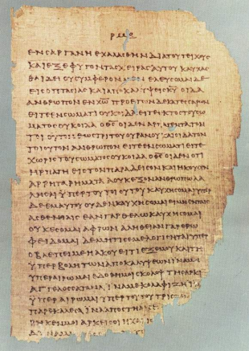
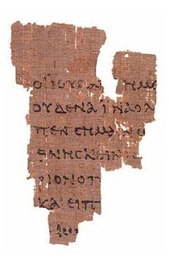
P 75 Luke
175-225
P 52 Jn.18: 31–33 /
37-38
c. 125-175
LUKE
P 75
1 Thess
P 46
P 46
1 Cor. 1 Thes. 175-225
1 Cor.
J
| | | | | | | | |
| | | | | | | | |
| | | | | | | | |
300 200 100 /\ 100 200 300 400 500 600 700 800 900 1000 1100 1200 1300 1400 1500

Slide 22
eventdate
gap
ms.
date
gap
Plutarch
Plutarch
Arrian
Arrian
Diodorus
Diodorus
Diodorus
Curtius
Curtius
Justin
Justin’s Abr. of Trogus 200 mss from the “middle ages” (could not find spec. dates)
TROGUS
A
| | | | | | | | |
| | | | | | | | |
300 200 100 /\ 100 200 300 400 500 600 700 800 900 1000 1100 1200 1300 1400 1500

Slide 23
...?...
DOC.
date
gap
ms.
date
gap …
Plutarch
Plutarch
Arrian
Arrian
Diodorus
Diodorus
Curtius
Curtius
Justin
Justin’s Abr. of Trogus 200 mss from the “middle ages” (could not find spec. dates)
TROGUS
Trogus abr.
by Justin
A
| | | | | | | | |
| | | | | | | | |
300 200 100 /\ 100 200 300 400 500 600 700 800 900 1000 1100 1200 1300 1400 1500

Slide 24
DOC
date
gap
ms
gap
LUKE
P 46
1 Cor. 1 Thes. 175-225
1 Thess
P 46
1 Cor.
J
| | | | | | | | |
| | | | | | | | |
| | | | | | | | |
300 200 100 /\ 100 200 300 400 500 600 700 800 900 1000 1100 1200 1300 1400 1500

Slide 25
DOC
date gap
ms
gap
P 75 Luke
3:18-
24:53 &John
175-225 AD
Though a few have proposed dates of end of 3rd or 4th cent.
LUKE
P 75
1 Thess
1 Cor.
J
| | | | | | | | |
| | | | | | | | |
| | | | | | | | |
300 200 100 /\ 100 200 300 400 500 600 700 800 900 1000 1100 1200 1300 1400 1500

Slide 26
DOC
Date
gap
ms
date
GAP
P 52
P 52 Jn.18: 31–33 /
37-38
c. 125-175
J
| | | | | | | | |
| | | | | | | | |
| | | | | | | | |
300 200 100 /\ 100 200 300 400 500 600 700 800 900 1000 1100 1200 1300 1400 1500

Slide 27
The gospels just legends from later times.
JOHN
21:24
Cf. 1 JOHN
1:1-4
None of them were written by eye witnesses.
The earlier
letters of Paul
(7 authentic ones) don’t tell the stories found in the gospels.

Slide 28
NEXT UP: EVIDENCE FOR
THE AUTHORSHIP & DATE
OF LUKE & ACTS

